Slide 1
Return to Play Guidelines & Critera
Unit One: Tissue Response to Injury

Slide 2
Intro
A study has indicated the re-injury rate for high school athletes who don’t have a Certified Athletic Trainer is 70%.
The re-injury rate for high school athletes who do have an Athletic Trainer is only 3%.
Why do you think there is such a big difference?

Slide 3
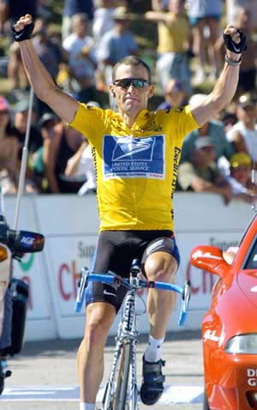
Objectives
Define Return to Play Terminology.
Identify Return to Play Steps.

Slide 4
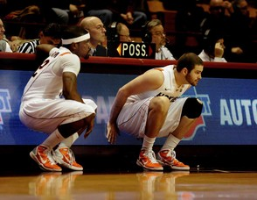
Return to Play
The process an injured athlete goes through in order to safely resume sports competition.

Slide 5
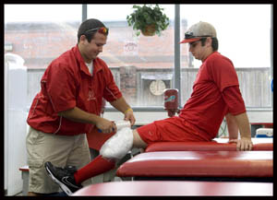
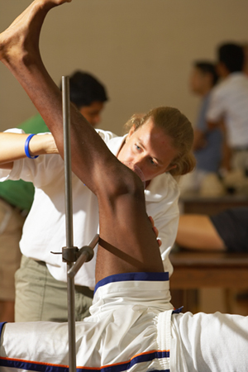
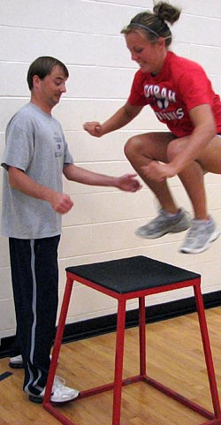
How do you decide?
If you were the athletic trainer or doctor, when would you release an athlete to return to play?
What would it take?
List the steps that the athlete would need to complete before returning to sports.

Slide 6
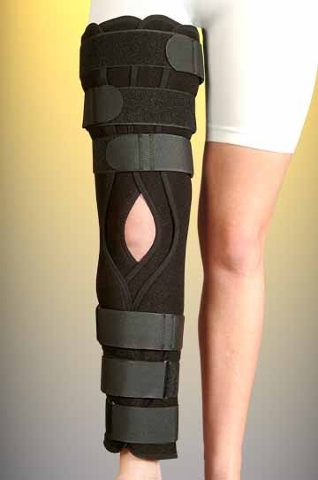
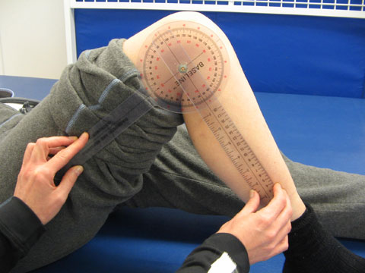
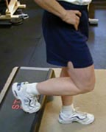
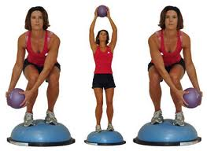
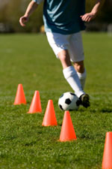
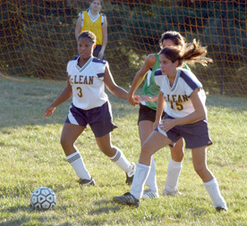
Return to Play
Immobilization
Range of Motion
Basic Strength
Balance, Speed, Power, and Agility
Sport-specific function
Partial Return to Play
Full Return to Play

Slide 7
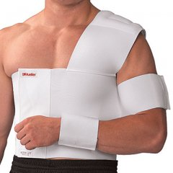
Immobilization
The period of time an athlete’s injury is held still in a cast, brace, sling, or splint in order for adequate healing to occur.

Slide 8
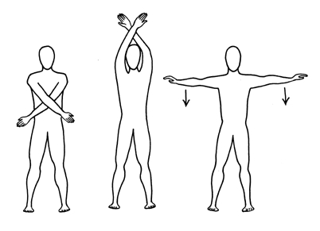
Range of Motion
The ability of the injured muscles & tissue to stretch far enough to allow the joint to complete its full ROM.

Slide 9
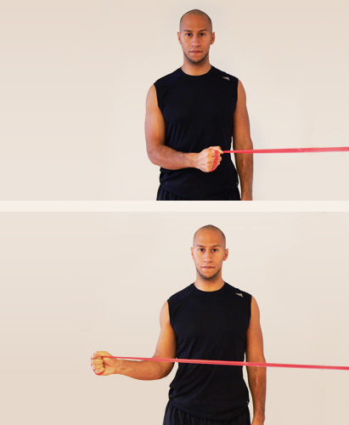
Basic Strength
Muscles with an injury must be able to produce force equivalent to at least 95% their pre-injured state.
Why would this matter?

Slide 10
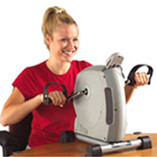
Speed
The ability of the athlete to cover ground quickly.
What other exercises could an athlete do to help with speed for a shoulder injury?

Slide 11
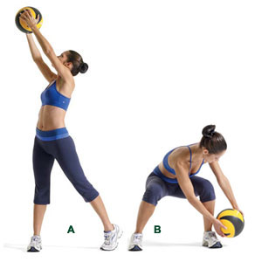
Sport Specific Function
The athlete’s ability to demonstrate skills and movement required in their sport.
Cutting, ladders drills,
side shuffles, squatting

Slide 12
Partial Return to Play
The injured athlete is released to participate in some, but not all practice activities.
Restrictions might include contact drills, abrupt changes in direction, over-exertion, etc.
Restrictions are dependent on the type and nature of the athlete’s injury and the level of rehabilitation progress.

Slide 13
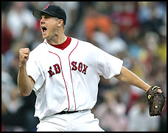
Full Return to play
Release to all practices and competitions without limitations or restrictions

Slide 14
Recall the steps
What are the 6 steps to return an athlete back to play?
Immobilization
Range of Motion
Basic Strength
Balance, Speed, Power, and Agility
Partial Return to Play
Full Return to Play

Slide 15
Criteria
What does “criteria” mean to you?
The specific level of the injured athlete must attain & demonstrate in order to progress to the next return to play step.

Slide 16
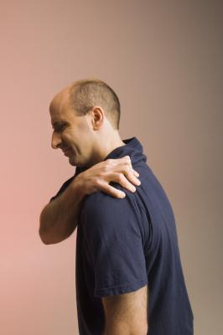
Immobilization to Range of Motion Criteria
Sufficient healing time recommended by the physician or athletic trainer before the removal of brace, cast, sling or splint
What would happen if we started ROM exercises too early?

Slide 17
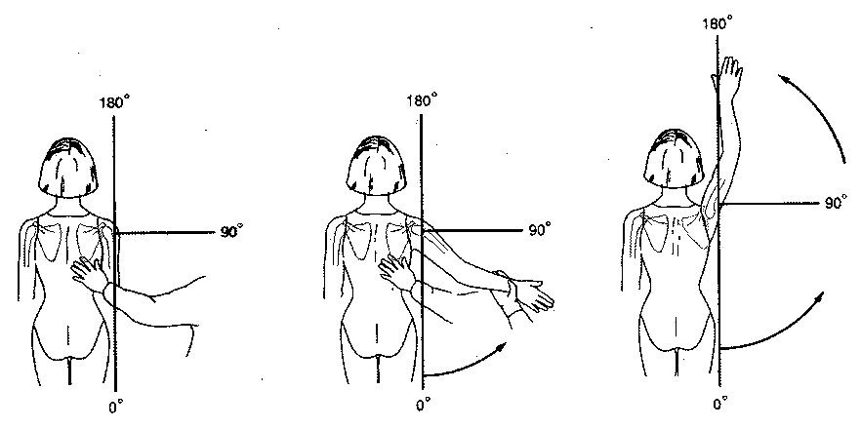
Range of Motion to Basic Strength Criteria
90% of normal ROM must be restored before beginning strengthening exercises

Slide 18
Range of Motion
The ability of the injured muscles & tissue to stretch far enough to allow the joint to complete its full range of motion.

Slide 19
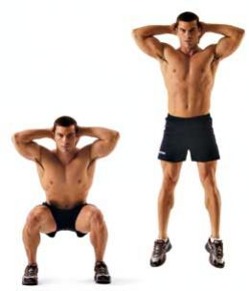
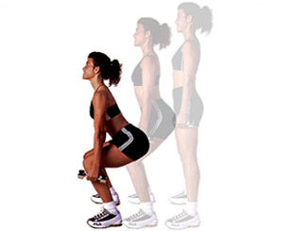
Basic Strength to Agility, Balance, Power, & Speed Criteria
Must have 90% of basic strength before beginning Agility, Speed and Power exercises

Slide 20
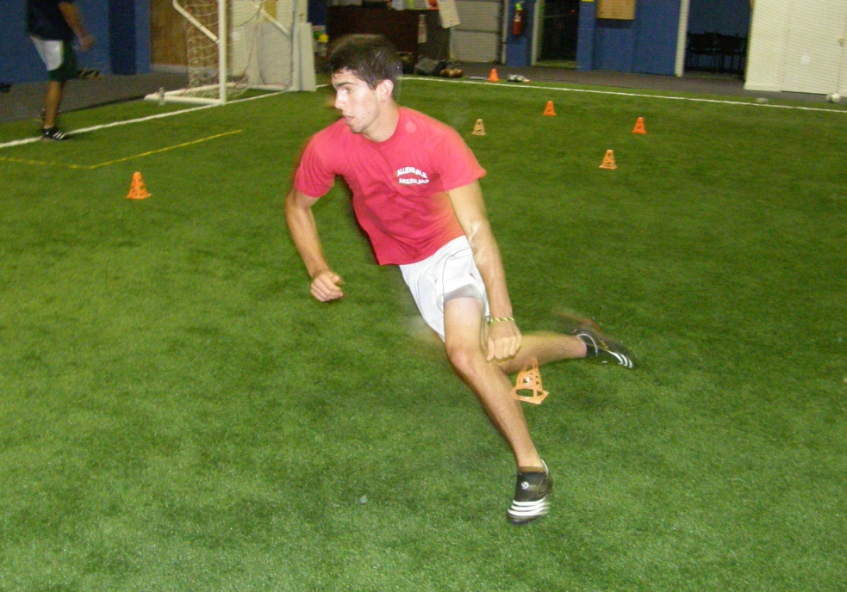
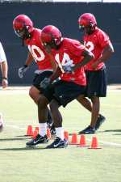
Agility, Balance, Power, & Speed to Sport-Specific Function Criteria
90% of Agility, power and speed before beginning Sport Specific Function

Slide 21
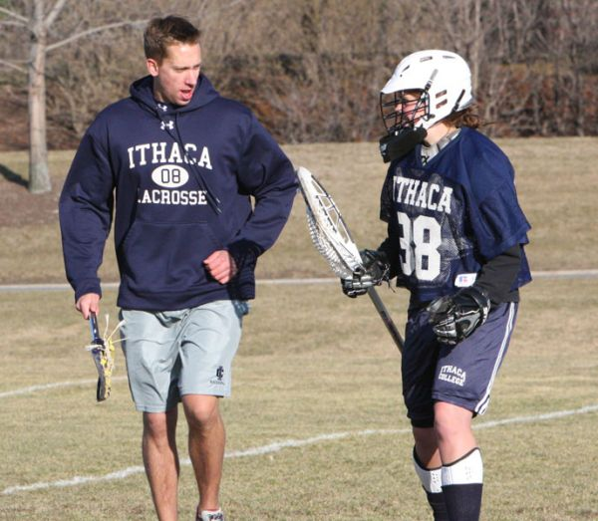
Sport-specific Function to Partial Return to Play Criteria
Athlete needs to demonstrate ability to perform skills necessary to participate in his/her sport

Slide 22
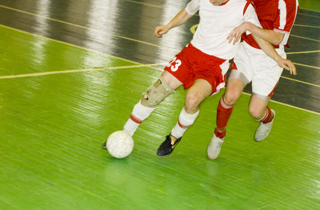
Partial Return to Play to Full Return to Play Criteria
Athlete is able to participate in limited practice without pain and no evidence of post-exercise swelling

Slide 23
Full Return to play
Release to all practices and competitions without limitations or restrictions

Slide 24
What’s the criteria?
The athlete has 90% pre-injury strength. What can he progress to?
Strength Agility, power, balance & speed

Slide 25
What’s the Criteria?
The athlete can now demonstrate full function with sport specific drills.
Sport specific function Partial Return

Slide 26
What’s the criteria?
The cast has been removed by the physician.
Immobilization Range of Motion

Slide 27
What’s the Criteria?
The athlete has shown no swelling, pain or problems in practice.
Partial return to play Full Return

Slide 28
Exit Card
On a small sheet of paper:
List the steps to Return to Play IN ORDER.

